Slide 1




Project: Shaper
Gülizar Çiçek
Project Based Learning
Oğuz Kağan EREN
Yaren Yılmaz

Slide 2

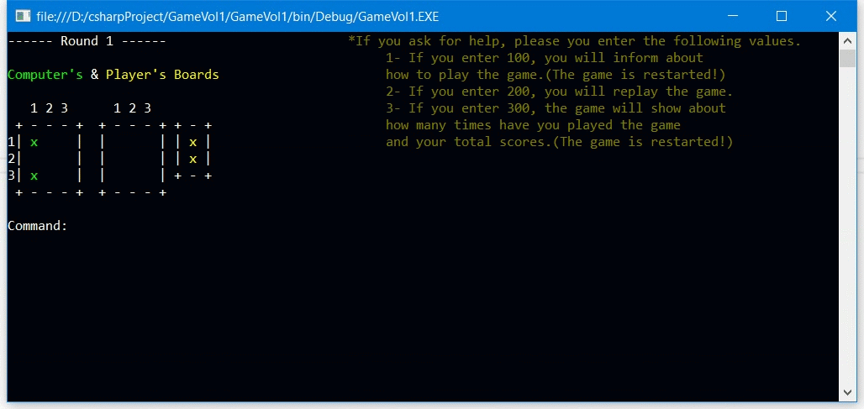
How to play the game?

Slide 3
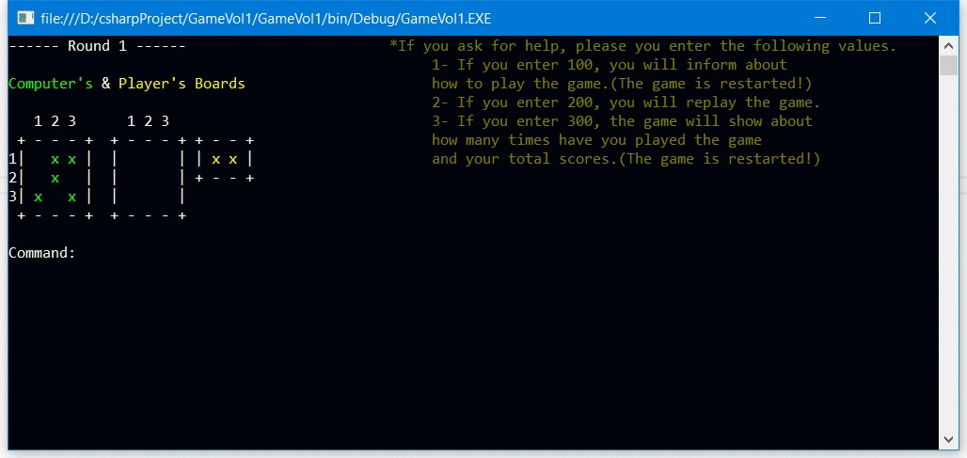
The Different things we made
Information about the game

Slide 4
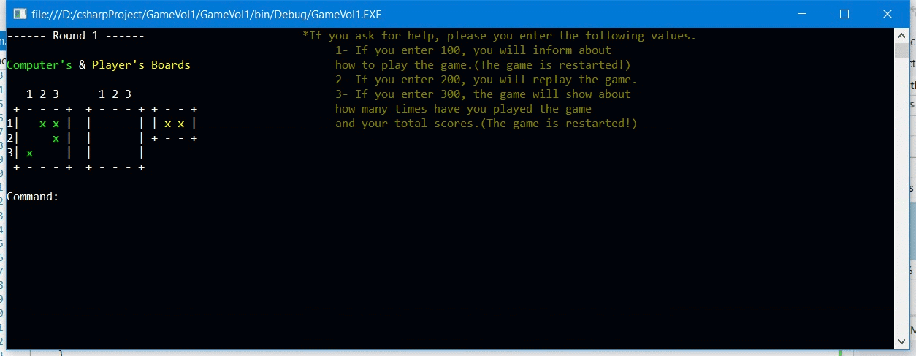
The Different things we made
Replay the game

Slide 5
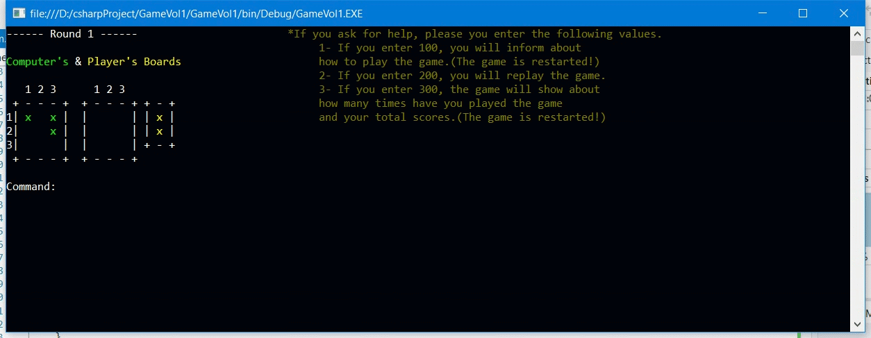
The Different things we made
Success rate of the player

Slide 6
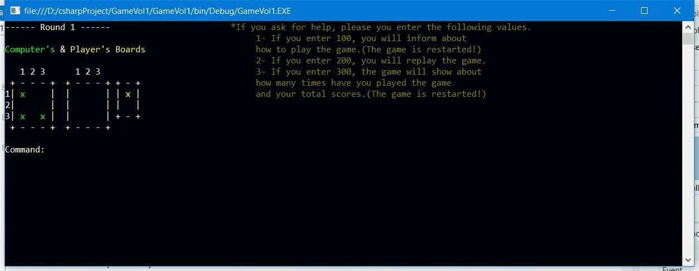
How did we execute rotation operations?

Slide 7
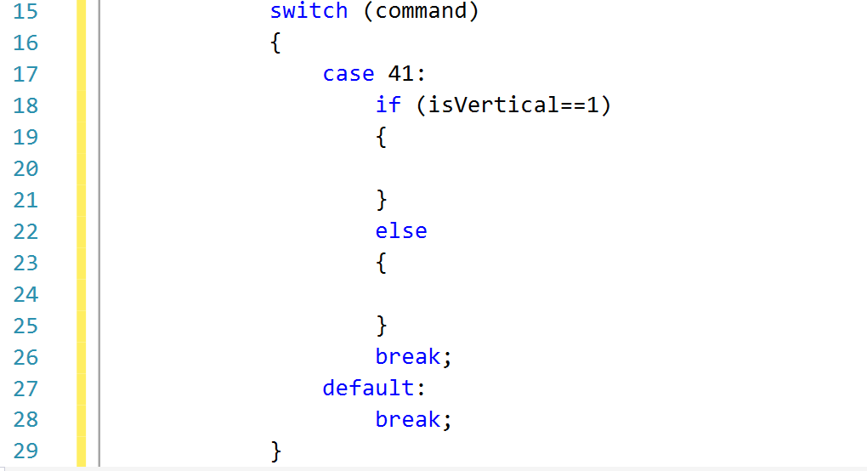
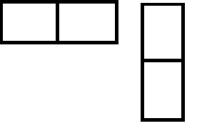
First Step: Is it vertical or horizontal?

Slide 8
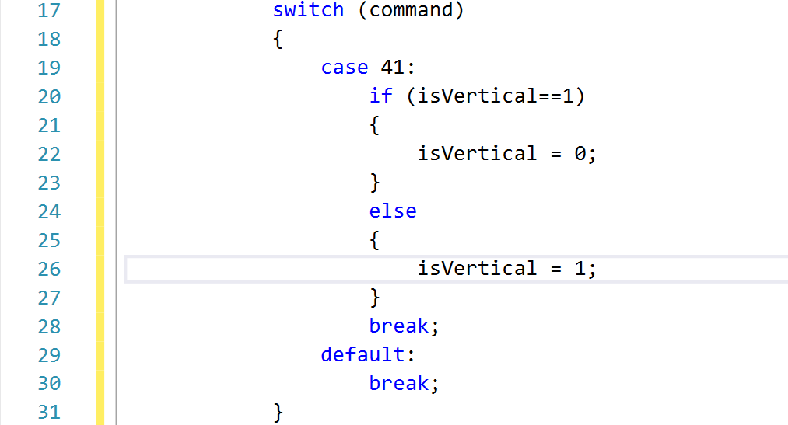
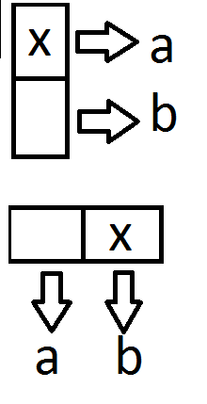
Second Step: rotating vertical or horizontal

Slide 9
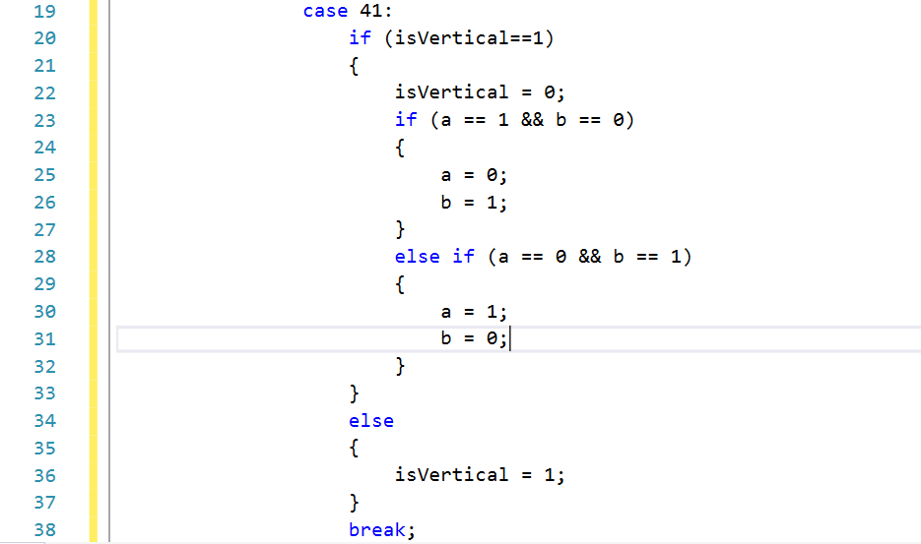
First Step: If the piece is vertical,…

Slide 10
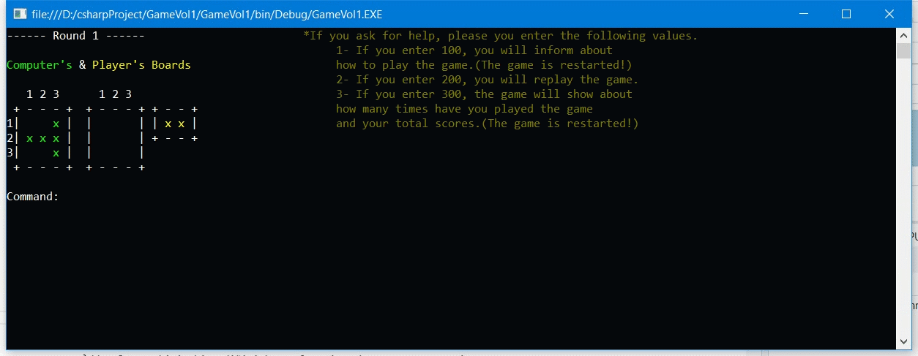
How did we control the errors of the game?

Slide 11
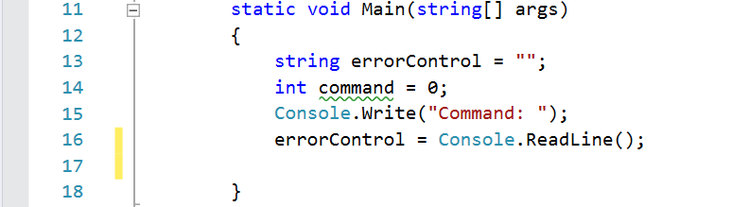
How did we control the errors of the game?

Slide 12
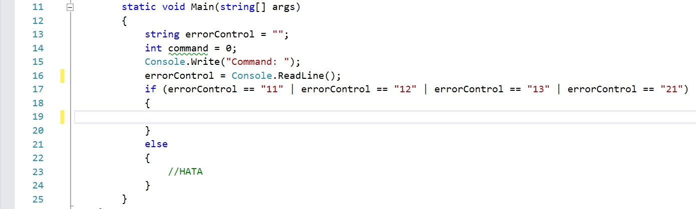
How did we control the errors of the game?

Slide 13
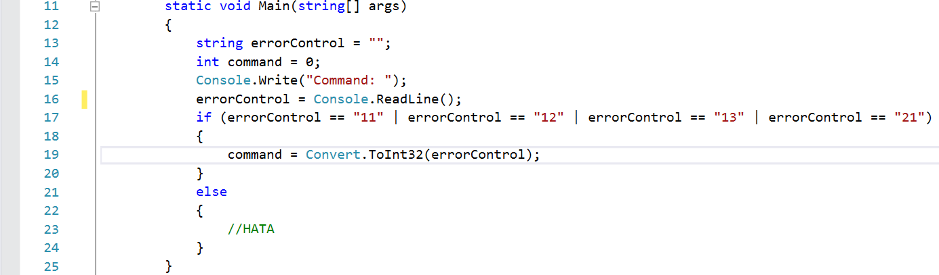
How did we control the errors of the game?

Slide 14
Thank you for your interest

